Slide 1
Formal Languages and Automata theory
Introduction: Alphabet, Languages

Slide 2
Symbol
...letters,digits or special symbols like @,$,#...
Eample:{ a,b c,.....0,1,,}
Alphabet
.....is a finite and nonempty set of symbols.
Denoted by ∑
Example:
∑={0,1}

Slide 3
String
....is a finite sequence of symbols from some alphabet
Example:
∑={a,b}
ab is a string
Possible strings over given alphabet ∑={a,b} of length 2
{aa,ab,ba,bb}
Possible strings over given alphabet ∑={a,b} of length 3
{aaa,aab,aba,abb,baa,bab,bba,bbb}
| ∑ |.... Number of symbols in alphabet.
Possible string of length n over ∑ is | ∑ |^{n}

Slide 4
Prefix of any string is any number of leading symbols of string.
Suffix of any string is any number of trailing symbols of string.
Example:string=”CSE”
Prefix: C,CS.
Suffix:E,SE.
Substring:C,S,E,CS,SE.

Slide 5
Length of a string is represented by |string|
Example
|abc|=3
If |String|= 0, it is called an empty string (Denoted by λ or ε)
Empty string is represented by λ or ε

Slide 6
Language
Collection of strings.
Example:
∑={a,b}
L1=set of all strings of length 2
{aa,ab,ba,bb}
L2=set of all strings of length 3
{aaa,aab,aba,abb,baa,bab,bba,bbb}
L3=set of all strings start with a
{a, aa,ab,aaa,aab.....}

Slide 7
The emptyset φ is a language over any alphabet. Similarly, { ε} is also a language over any alphabet.
φ ≠ {ε } because the language φ does not contain any string
but {ε }contains a string, namely ε.
| φ| = 0
whereas, |{ε } |= 1.

Slide 8
Kleene Closure
∑⁰=set of all strings over ∑ of length ‘0’
∑¹=set of all strings over ∑ of length ‘1’
∑²=set of all strings over ∑ of length ‘2’
Example:
∑={0,1} then
∑⁰={ε}
∑¹={0,1}
∑²={00,01,10,11}
∑*= ∑⁰U ∑¹U ∑²....
∑*={ε,0,1,00,01,10,11..}

Slide 9
Kleene Closure of a Language
∑={0,1} and L is a language over ∑ then
L⁰={ε}
L¹={0,1}
L²={00,01,10,11}
L*= L⁰U L¹U L²....
L*={ε,0,1,00,01,10,11...}

Slide 10
positive Closure
If ∑ is an alpha bet positive clourse of ∑ is denoted by ∑⁺ and defined as
∑⁺= ∑*-{ε}
Set of all strings over ∑ excluding ε
Example:
∑={0}then ∑⁺= {0,00,000,....}

Slide 11
Language
Finite Representation
string
Yes
No

Slide 12
Number of possible strings over ∑*?
Number of possible Languages over ∑*?

Slide 13
Operations on languages
If L1 and L2 are two languages then
Union of two languages is denoted as L1 + L2 or L1 U L2
Concatenation of two languages is denoted as L1L2
By concatenation one can combine two strings to form a new string ,whose length is sum of lengths of original strings.
The result of concatenating a string with empty string is the original string.
Kleene closure
∑*= {∑⁰U ∑¹U ∑²....}
∑={0,1} then
∑*={ε,0,1,00,01,10,11..}

Slide 14
Operations on languages
Positive closure
∑⁺= ∑*-{ε}
Set of all strings over ∑ excluding ε
∑={0}then ∑⁺= {0,00,000,....}
Examples:
L={good,bad} M={boy,girl}
LUM={good,bad,boy,girl}
LM={goodboy,goodgirl,badboy,badgirl}

Slide 16
Grammars
Grammar is basically defined as set of 4-tuple(V,T,P,S) where
V----is set of non Terminals
T----is set of Terminals(primitive symbols)
P----is set of Productions which relate the non terminals and terminals.
S---- is start symbol with which strings in grammar are derived.

Slide 17
Example:
Let us examine the rules used to define a sentence in English Language
<Sentence> → <Noun><verb>
<Noun> → <commonnoun>|<propernoun>
<Verb> → ate|sat|ran
<propernoun>→Rama|Sita
<commonnoun> → she|he
We can derive the following sentences by above rules
Rama ate.
Sita sat
he ran

Slide 18
V = {= <Sentence> , <Noun>,<verb>, <propernoun>, <commonnoun> }
Σ = {Ram, sita}
P = <Sentence> → <Noun><verb>
<Noun> → <commonnoun>|<propernoun>
<Verb> → ate|sat|ran
<propernoun>→Rama|Sita
<commonnoun> → she|he
S = <Sentence>

Slide 19
Derivation
<Sentence> → <Noun><verb> <Noun> → <commonnoun>|<propernoun> <Verb> → ate|sat|ran <propernoun>→Rama|Sita <commonnoun> → she|he
Rama ate.
Sentence
Noun
verb
propernoun
ate
Rama

Slide 20
Language acceptance
Start with start symbol and at every step replace the non terminal by right hand side of the rule.
Continue this until string of terminals is derived.
The string of terminals gives language accepted by grammar.

Slide 21
Consider the language represented by a+={a,aa,aaa,....}
Grammar:
S → a
S → aS
Now we get strings as follow s starting with S
S → a {a}
S → aS → aa {aa}
S → aS → aaS → aaa {aaa}

Slide 22
Derivation
Grammar:
S → a
S → aS
V={S}
T={a} a
P={S → a S → aS } a
Starting symbol is S
Example :derive string “aaa”
S
S
s
a

Slide 23
Chomsky Hierarchy
Linguist noam Chomsky defined hierarchy of languages in terms of complexity.
This four level hierarchy called Chomsky Hierarchy.

Slide 24
Type 0 Grammar
These grammars include all formal grammars.
All productions are in the form α → β
Where α and β have any number of terminals and non terminals.
No restriction on either side of production.
Every grammar included in it if it has at least one non terminal on the left hand side.
Example:
aA → abCB
aA->bAA
They generate the languages that are recognized by a Turing machine.
. These languages are known as recursively enumerable languages.

Slide 25
Type 1 grammar Context sensitive Grammars(CSG)
The productions must be in the form
α A β → α γ β
where A ∈ N (Non-terminal)
and α, β, γ ∈ (T ∪ N)* (Strings of terminals and non-terminals)
The strings α and β may be empty, but γ must be non-empty.
We can replace A by γ where A lies in between α and β.
hence the name context sensitive grammar.
It cannot include S → ε
The languages generated by these grammars are recognized by a linear bounded automaton.
Example:
aAbcD → abcDbcD

Slide 26
Type 2 Grammar-ContextFree Grammar(CFG)
These grammars define the context free languages.
These are defined by rules of the form α → β
Where | α |=1 and is a nonterminal and
β is a string of terminals and non terminals.
We can replace α by β where it appears.Hence the name context free grammars.
Recognized by a non deterministic push down automata.
CFL anguages define Syntax of all programming languages
Example:
S → aS|Sa|a
S → aAA|bBB| ε

Slide 27
Type3 –Regular Grammar(RG)
These grammars generate the regular languages.
Productions in this grammar contains single non terminal on left hand side.
The right hand side consists of either a single terminal or strings of terminals with single non terminal on left or right end.
Example
A → aB|a //Right Linear grammar
A → Ba|a //Left Linear grammar
S → ε is allowed here.
These languages are recognized by finite automaton.
Regular languages are used to define search patterns and lexical structure of programming languages.

Slide 28
Finite Automata
Finite automaton is the mathematical model of a digital computer.
Finite automata are used as string or language acceptors.
They are mainly used in pattern matching tools like Lex and text editors.

Slide 29
Finite automaton definition
Formally defined as 5-tuple(Q, ∑, δ,q₀,F)
Where
Q---- is finite set of states which is non empty
∑ ----is input alphabet
q₀₋₋₋₋₋₋₋ is initial state
F –----is set of final states and F ⊆ Q
δ --------is transition function or mapping function Qx ∑ → Q
Using this next state can be determined depending on current input.

Slide 30
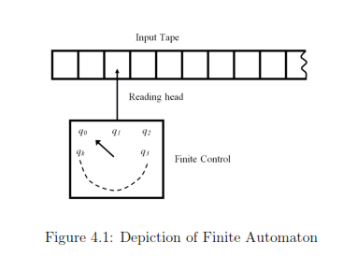
Finite automaton model

Slide 31
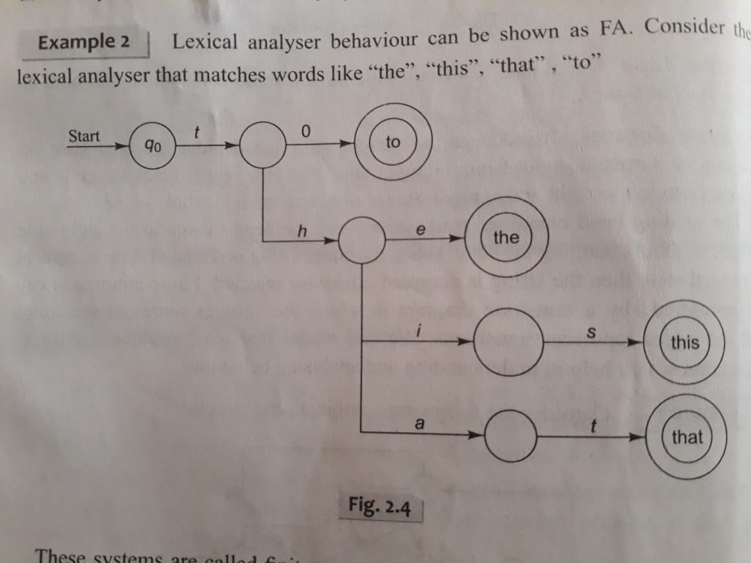

Slide 32
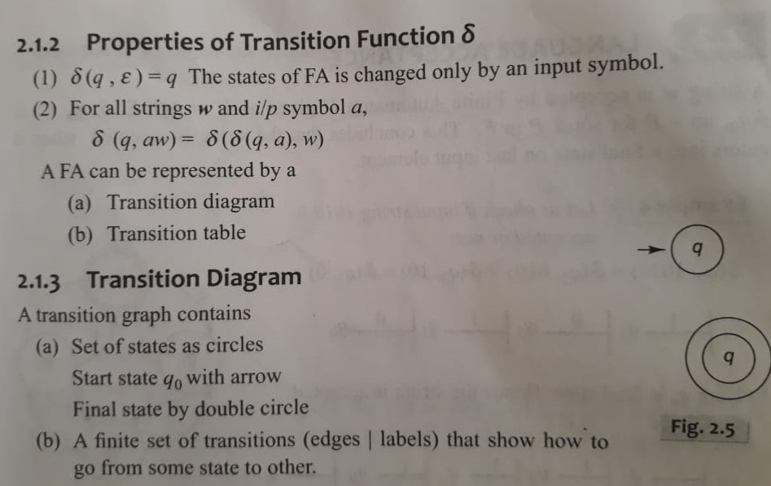

Slide 33
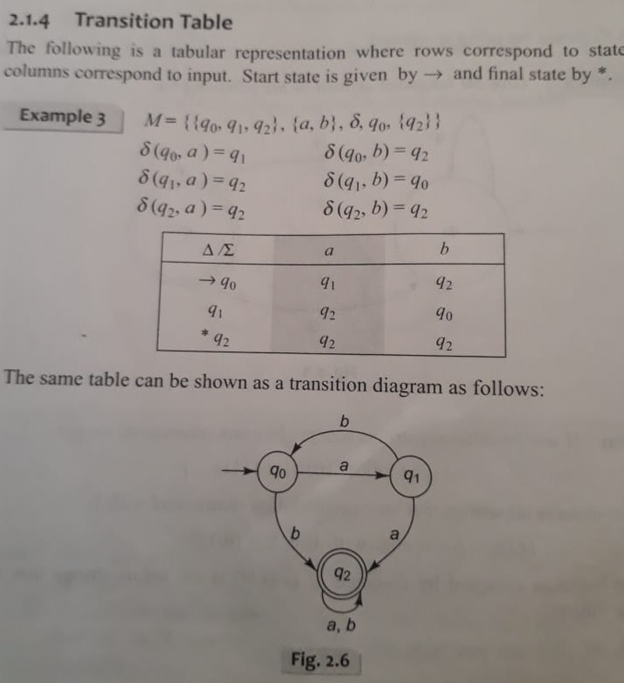
Now check “abaa” is accepted by it or not?

Slide 34
Finite automaton is of two types
1)Deterministic Finite Automaton(DFA)
2)Non Deterministic Finite Automaton(NFA)
In DFA there will be unique transition in any state on an input symbol.
In NFA there can be more than one transition on an input symbol.
Hence DFA is faster than NFA.

Slide 35
Deterministic Finite Automaton(DFA)
defined as quintuple(Q, ∑, δ,q₀,F)
Where
Q---- is finite set of states which is non empty
∑ ----is input alphabet
q₀₋₋₋₋₋₋₋ is initial state
F –----is set of final states and F ⊆ Q
δ --------is transition function that takes two arguments a state and input symbol and return output as state Qx ∑ → Q
Ex: δ(q1,a)=q2

Slide 36
Design a DFA which accepts only input 101 over the set {0,1} 1,0
q0
1
q1
0
q2
1
q3
1
0
0
qtrap

Slide 37
Examples
Design a DFA that accepts an odd number of 1’s on{0,1}
Design a DFA to accept set of all strings containing 3 consecutive 0’s.
Design a DFA that accepts all the strings of length 2 over ∑ ={a,b}

Slide 38
NonDeterministic Finite Automaton(NFA)
For a given input symbol there can be more than one transiition from a state.such automaton is called NonDeterministic Finite Automaton.
defined as quintuple(Q, ∑, δ,q₀,F)
Where
Q---- is finite set of states which is non empty
∑ ----is input alphabet
q₀₋₋₋₋₋₋₋ is initial state
F –----is set of final states and F ⊆ Q
δ --------is transition function that takes two arguments a state and input symbol and return output as state Qx ∑ → 2^{Q}

Slide 39
Design NFA accepting all strings ending with 01 over {0,1}.

